Slide 1
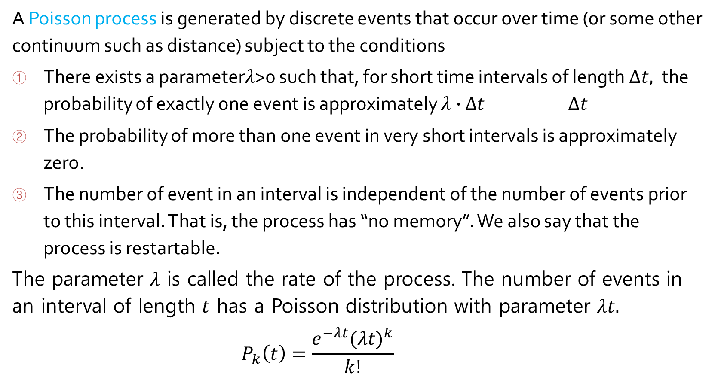
Poisson process (https://www.pp.rhul.ac.uk/~cowan/stat/notes/PoissonNote.pdf)
A Poisson process is generated by discrete events that occur over time (or some other continuum such as distance) subject to the conditions
There exists a parameter$λ$>0 such that, for short time intervals of length $∆t,$the probability of exactly one event is approximately $λ∙$ $∆t$ $∆t$
The probability of more than one event in very short intervals is approximately zero.
The number of event in an interval is independent of the number of events prior to this interval. That is, the process has “no memory”. We also say that the process is restartable.
The parameter $λ$ is called the rate of the process. The number of events in an interval of length $t$ has a Poisson distribution with parameter $λt.$
$$P_{k}\left(t\right)=\frac{e^{−λt}{(λt)}^{k}}{k!}$$

Slide 2
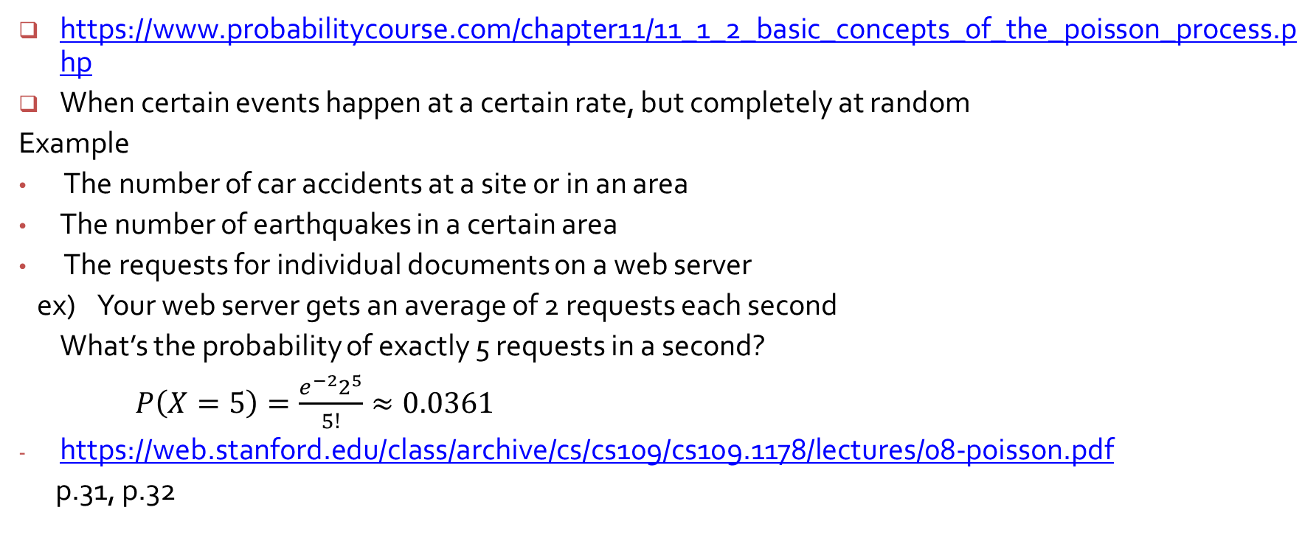
Poisson Process
https://www.probabilitycourse.com/chapter11/11_1_2_basic_concepts_of_the_poisson_process.php
When certain events happen at a certain rate, but completely at random
Example
The number of car accidents at a site or in an area
The number of earthquakes in a certain area
The requests for individual documents on a web server
ex) Your web server gets an average of 2 requests each second
What’s the probability of exactly 5 requests in a second?
$P\left(X=5\right)=\frac{e^{−2}2^{5}}{5!}≈0.0361$
https://web.stanford.edu/class/archive/cs/cs109/cs109.1178/lectures/08-poisson.pdf
p.31, p.32

Slide 3
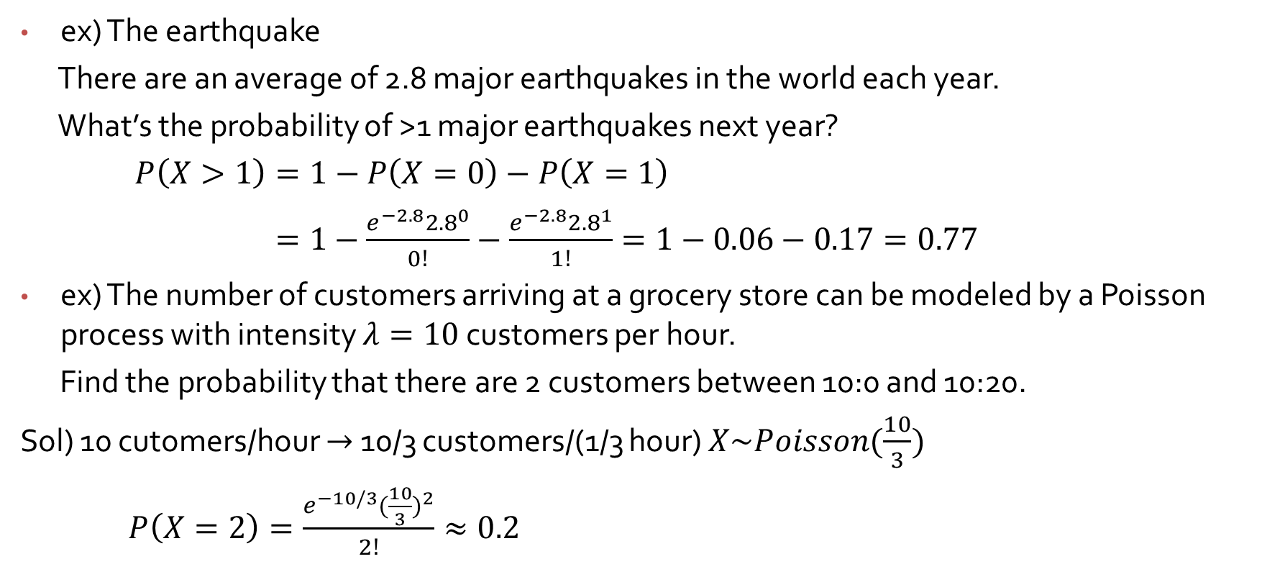
Poisson Process
ex) The earthquake
There are an average of 2.8 major earthquakes in the world each year.
What’s the probability of >1 major earthquakes next year?
$P\left(X>1\right)=1−P\left(X=0\right)−P\left(X=1\right)$
$=1−\frac{e^{−2.8}{2.8}^{0}}{0!}−\frac{e^{−2.8}{2.8}^{1}}{1!}=1−0.06−0.17=0.77$
ex) The number of customers arriving at a grocery store can be modeled by a Poisson process with intensity $λ=10$ customers per hour.
Find the probability that there are 2 customers between 10:0 and 10:20.
Sol) 10 cutomers/hour $→$10/3 customers/(1/3 hour) $X\sim Poisson(\frac{10}{3})$
$P\left(X=2\right)=\frac{e^{−10/3}{(\frac{10}{3})}^{2}}{2!}≈0.2$

Slide 4
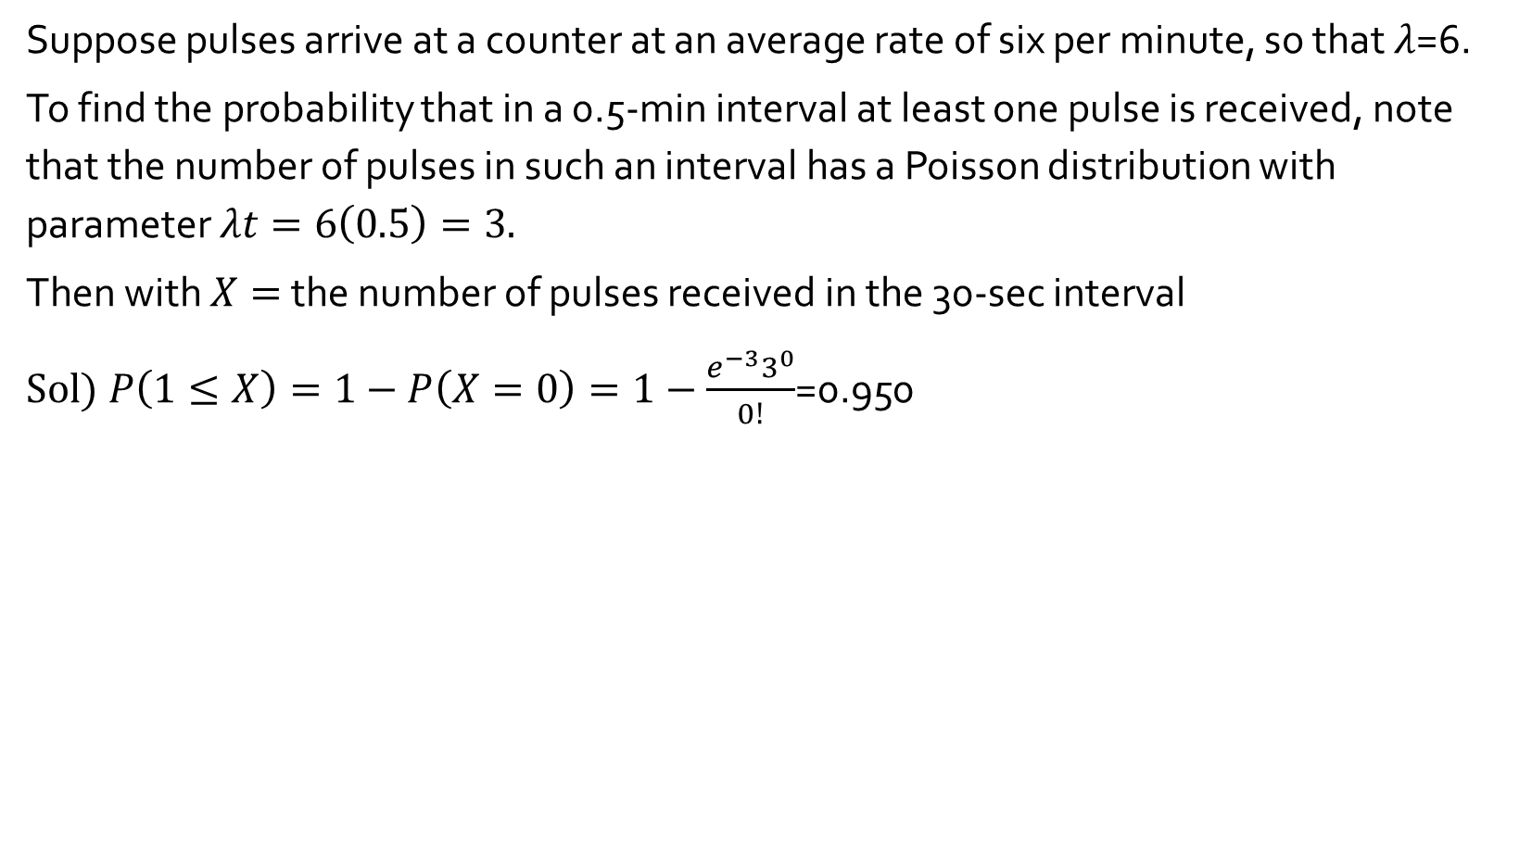
Example 3.42
Suppose pulses arrive at a counter at an average rate of six per minute, so that $λ$=6.
To find the probability that in a 0.5-min interval at least one pulse is received, note that the number of pulses in such an interval has a Poisson distribution with parameter $λt=6\left(0.5\right)=3.$
Then with $X=$ the number of pulses received in the 30-sec interval
Sol) $P\left(1≤X\right)=1−P\left(X=0\right)=1−\frac{e^{−3}3^{0}}{0!}$=0.950

Slide 5
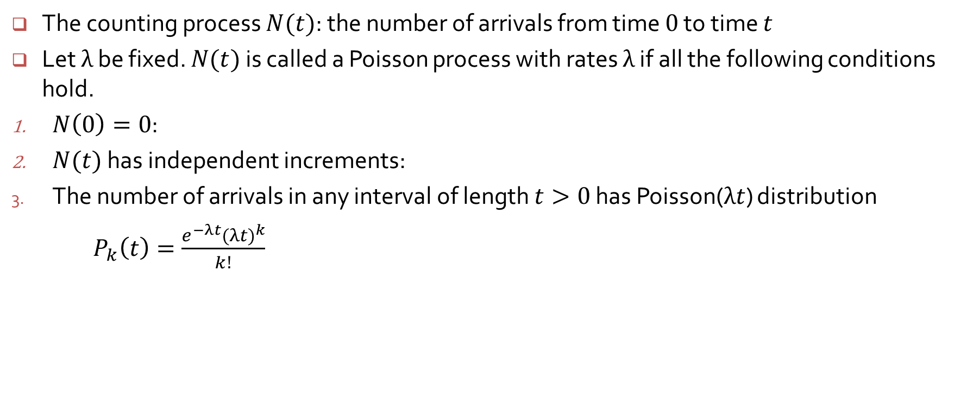
Poisson Process**
The counting process $N(t)$: the number of arrivals from time $0$ to time $t$
Let $λ$ be fixed. $N(t)$ is called a Poisson process with rates $λ$ if all the following conditions hold.
$N\left(0\right)=0$:
$N(t)$ has independent increments:
The number of arrivals in any interval of length $t>0$ has Poisson($λt$) distribution
$P_{k}\left(t\right)=\frac{e^{−λt}{(λt)}^{k}}{k!}$

Slide 6
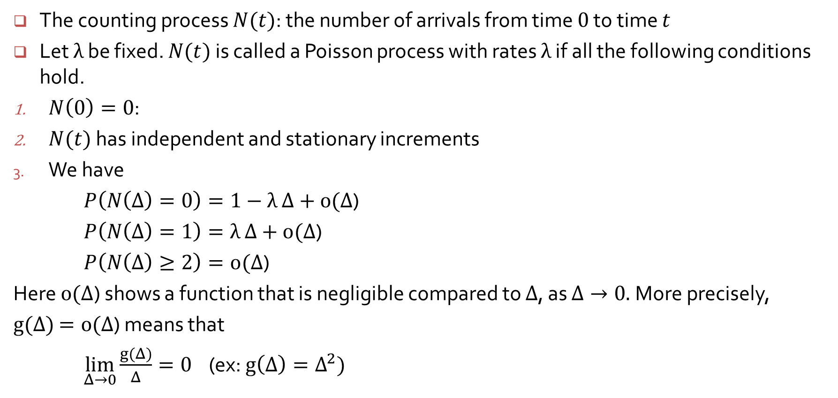
Second Definition of the Poisson Process**
The counting process $N(t)$: the number of arrivals from time $0$ to time $t$
Let $λ$ be fixed. $N(t)$ is called a Poisson process with rates $λ$ if all the following conditions hold.
$N\left(0\right)=0$:
$N(t)$ has independent and stationary increments
We have
$P\left(N\left(Δ\right)=0\right)=1−$ $λ$ $Δ+o(Δ$)
$P\left(N\left(Δ\right)=1\right)=λ$ $Δ+o(Δ$)
$P\left(N\left(Δ\right)≥2\right)=o(Δ$)
Here $o(Δ$) shows a function that is negligible compared to $Δ$, as $Δ→0.$More precisely,
$g(Δ)$ $=o(Δ$) means that
$\lim_{Δ→0}{\frac{g(Δ)}{Δ}}=0$ (ex: $g\left(Δ\right)=Δ^{2})$

Slide 7

Second Definition of the Poisson Process**
$N\left(t\right)=\frac{e^{−λt}{(λt)}^{x}}{x!}$
$P\left(N\left(Δ\right)=0\right)=e^{−λΔ}=1−$ $λΔ+\frac{λ^{2}}{2}Δ^{2}−⋯$ (Taylor series)
If $Δ$ is small,
$P\left(N\left(Δ\right)=0\right)=1−$ $λΔ+o(Δ$)
$P\left(N\left(Δ\right)=1\right)=e^{−λΔ}λΔ=$ $λΔ\left(1− λΔ+\frac{λ^{2}}{2}Δ^{2}−⋯\right)$
$=$ $λΔ+\left(−λ^{2}Δ^{2}+\frac{λ^{3}}{2}Δ^{3}−⋯\right)=λΔ+o(Δ\text{)}$
$P\left(N\left(Δ\right)≥2\right)=1−P\left(N\left(Δ\right)=0\right)−P\left(N\left(Δ\right)=1\right)$
$=o(Δ\text{)}$

